Slide 1

.Net Standard 2.0

Slide 2
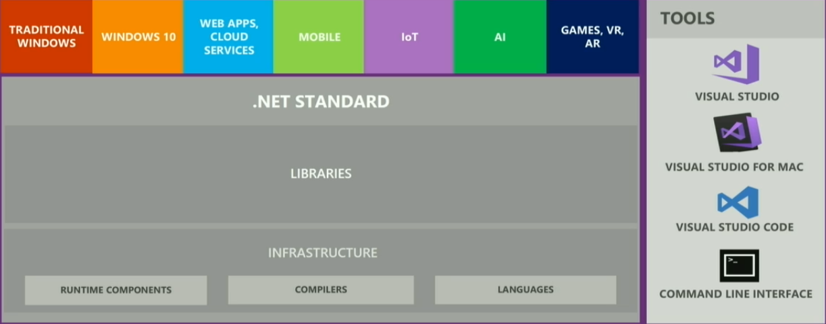
Unified Platform

Slide 3
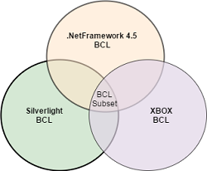
Portable Class libraries
It is a reusable library project where we specify the .Net Platforms we are planning to target during creation of library.
Advantage: allowed code sharing between multiple platforms.

Slide 4

Disadvantages of PCL
Adding a new platform support requires re-compiling against the new set of target platforms and removing the API references that are not part of new intersection of base class libraries and does not have any control on the target platforms which were still evolving separately.
There are many Verticals for .Net Platforms with similar base class libraries.

Slide 5

Can we build libraries for common Platform?
Answer: .Net Standard !!!

Slide 6
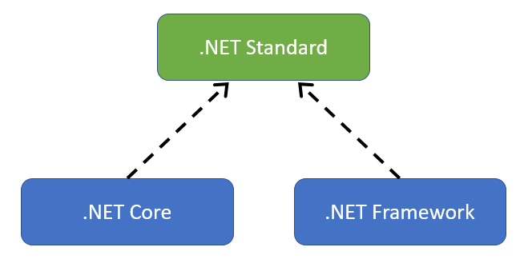
What is .Net Standard?
It is a subset of all Base Class Libraries of different .Net Platforms (e.g. full .Net Framework, .Net Core, Xamarin, Silverlight, XBox etc).
It is an Interface which is implemented by .NetCore or .NetFramework projects.

Slide 7
Is it a Framework or Platform?
.Net Standard is not a framework or platform of its own. It does not have implementations or a runtime, just defines a specification what different .Net platforms has to implement to remain .Net Standard complaint.
Eg.. .Net Core is a framework with runtime that implements .NetStandard.
Platform - hardware / architecture (x86 vs x64) / operating system.
Framework - software / libraries / scaffolding.

Slide 8
.NetStandard Features
.NET Standard is for sharing code: It replaces Portable Class Libraries (PCLs) as the tool for building .NET libraries that work everywhere.
Much bigger API Surface: We have more than doubled the set of available APIs from 13k in .NET Standard 1.6 to 32k in .NET Standard 2.0. Most of them are existing .NET Framework APIs. These additions make it much easier to port existing code to .NET Standard,
.NET Framework compatibility mode: Compatibility mode is added, that allows .NET Standard projects to reference .NET Framework libraries.

Slide 9
Broad Platform Support.
.NET Framework 4.6.1
.NET Core 2.0
Mono 5.4
Xamarin.iOS 10.14
Xamarin.Mac 3.8
Xamarin.Android 7.5
UWP is work in progress and will ship later this year.

Slide 10
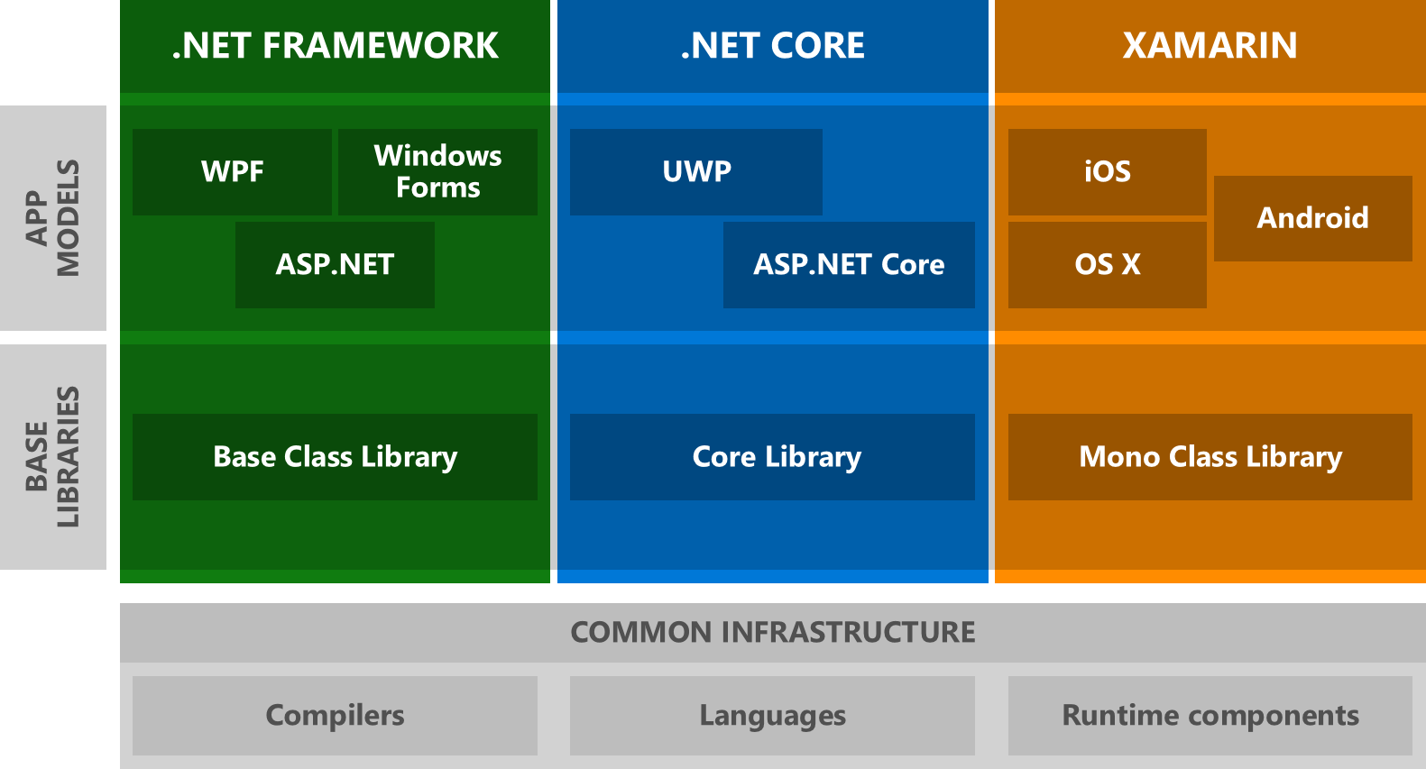
Architecture Diagram with Base Class Library

Slide 11
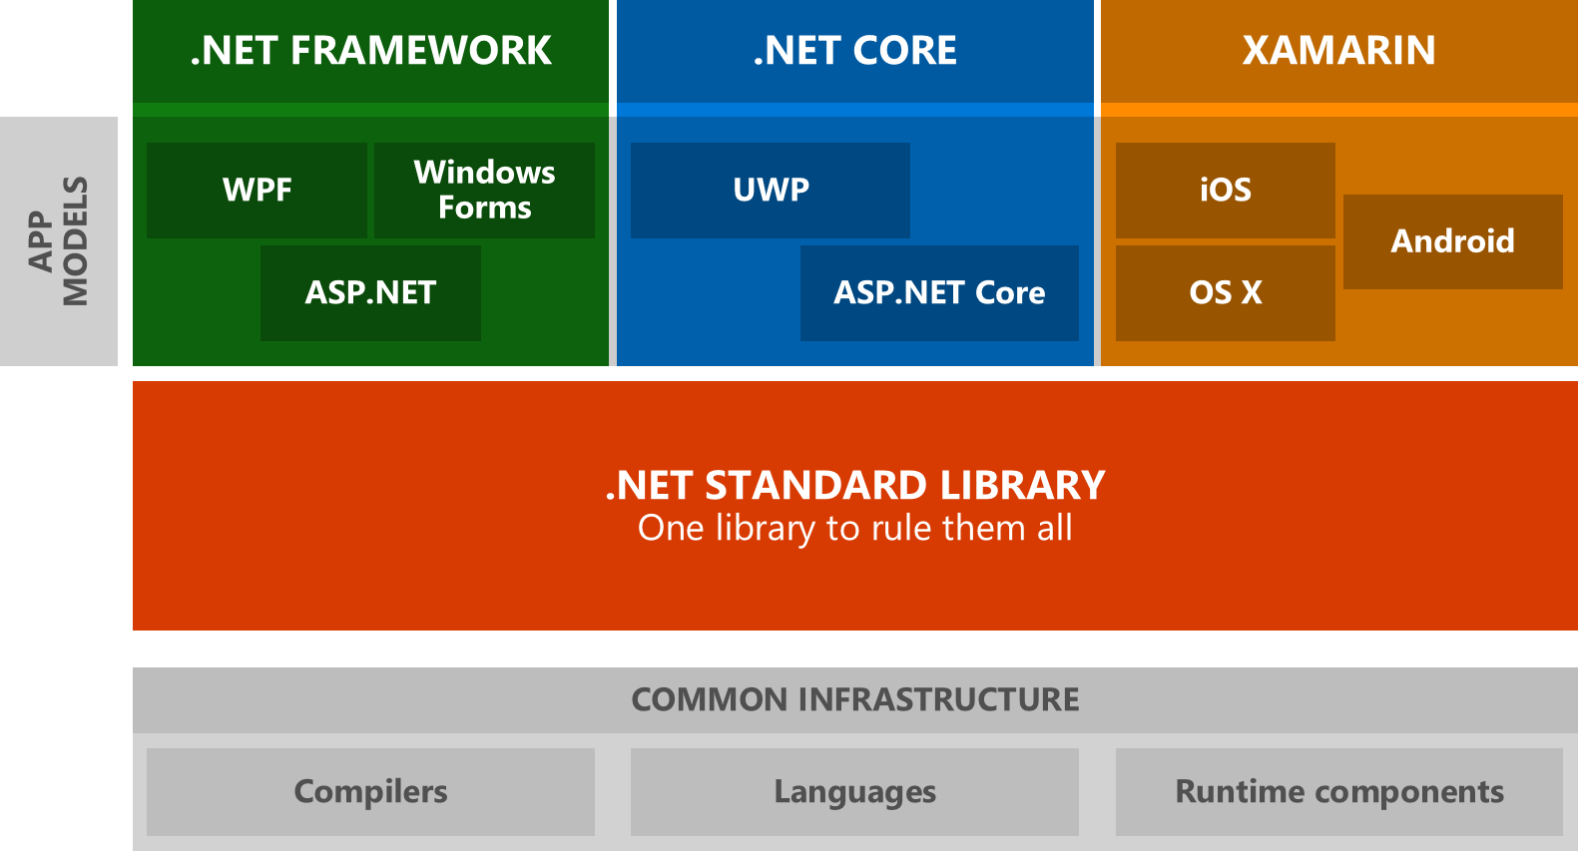
Architecture Diagram with .NetStandard.dll

Slide 12
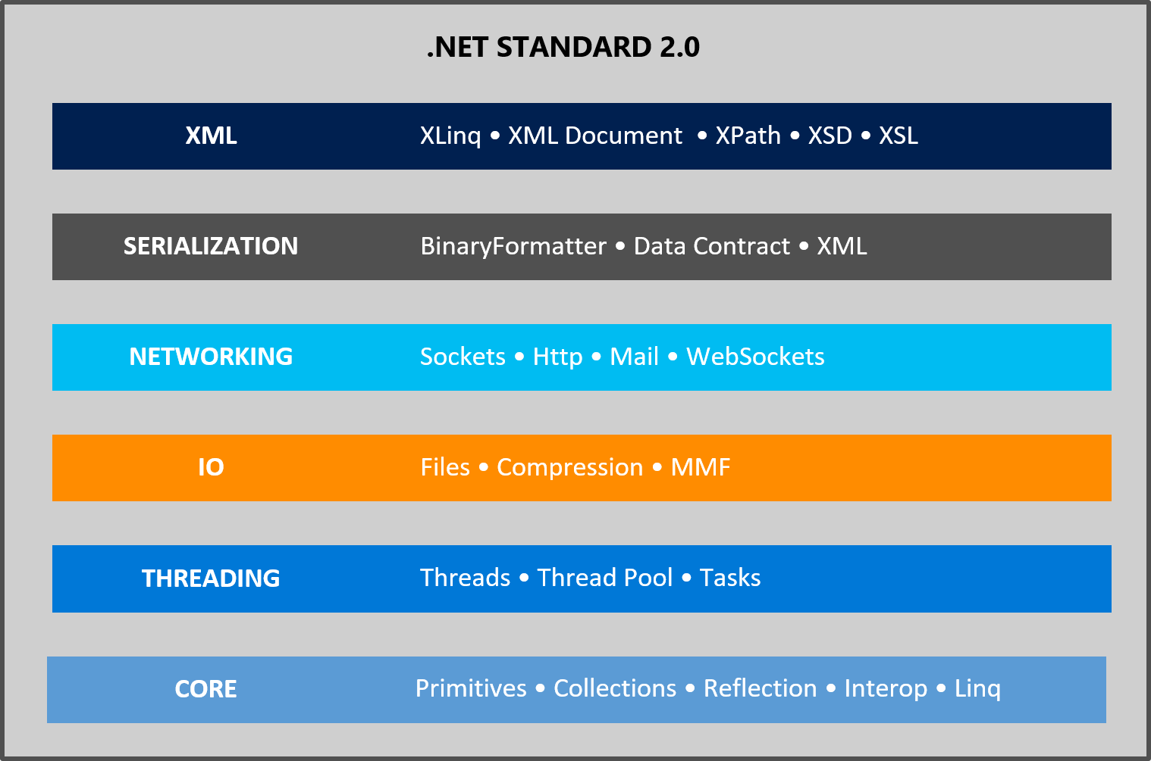
API’s in .NET Standard 2.0

Slide 13
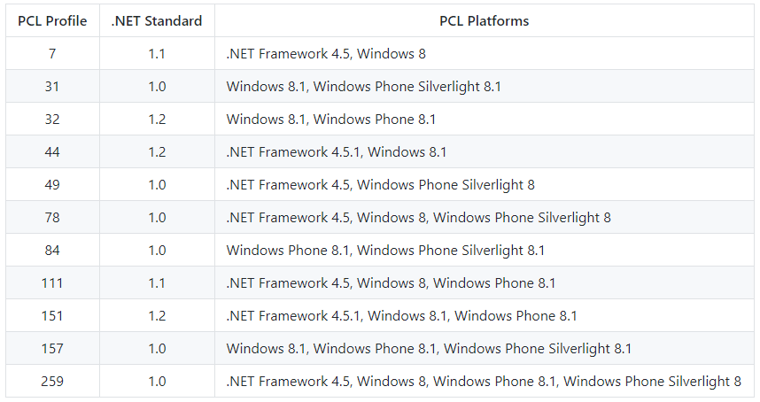
Mapping PCL Profiles to .NET Standard

Slide 14
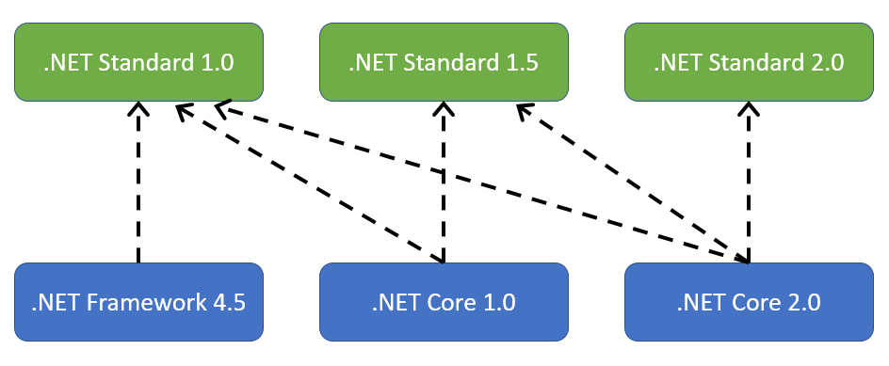
Which .NET Standard version should you target?
The higher the version, the more APIs are available to you.
The lower the version, the more platforms implement it.
13k in .NET Standard 1.6 to 32k in .NET Standard 2.0.
To develop a library that supports .NetFramework 4.5.1 and .Net Core 1.0, we need to target .Net Standard 1.2 i.e. the lowest .NetStandard version that the 2 frameworks implement.

Slide 15
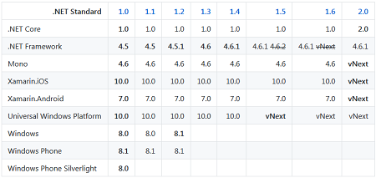
.Net Standard Versions and Platform Support

Slide 16
.Net Standard Version and Platform Supports
A library targets a specific framework. .NET Standard is a synthetic framework, which represents a standardized set of APIs across all .NET platforms. A library can also target a specific .NET platform, in which case it gets access to platform-specific APIs. For example, when targeting Xamarin.iOS you also get access to iOS APIs.
A .NET platform implements a specific .NET Standard version.
A .NET platform supports all .NET Standard versions that are equal to or lower than the version it implements. For instance, if a .NET platform implements .NET Standard 1.5, it supports 1.0 - 1.5. If it implements .NET Standard 2.0, it supports 1.0 - 2.0

Slide 17
Highlights on .Net Standard APi’s
The AppDomain type is part of .NET Standard. The primary reason we expose this type in .NET Standard is because the usage is fairly high and typically not associated with creating new app domains but for interacting with the current app domain, such as registering an unhandled exception handler or asking for the application's base directory.
No Remoting dll's are part of .Net Standard but MarshalByRefObject.
.NET Standard contain the abstractions (DbProvider, DbProviderFactories, DbConnection, IDbConnection etc.) as well as the general ADO.NET facilities (DataSet, DataTable etc.) APIs. Providers are not part of .Net Standard as they remain platform specific.

Slide 18
Highlights on .Net Standard APi’s cont..
JSON.NET not part of .NET Standard.
"Type" for example, methods, properties, etc is not added to .net Standard. It remains platform specific.
Unity is not supported currently.
Extensions exist outside of the .NET Standard and must be manually referenced.
In .NET Standard you are only getting what is in the BCL, not what we know as the Framework Class Library (FCL). Frameworks in this case are application platforms like ASP.NET (System.Web and OWin based), WinForms, WPF, WCF etc. For .NET Core ASP.NET 5 is an Application Framework that lives on top of .NET Standard.

Slide 19
TPL library for .net Standard
Threadpool would be a nomination in .NET 2.0 which is kind of similar with TP. Provides a pool of threads that can be used to execute tasks, post work items, process asynchronous I/O, wait on behalf of other threads, and process timers.
TPL actually uses Threadpool under the hood. TPL handles the partitioning of the work, the scheduling of threads on the ThreadPool, cancellation support, state management, and other low-level details.
BackgroundWorker class which has been available from .NET Framework 2.0+

Slide 20
Inclusive Principles
Ubiqutous APIs. APIs in the .NET Standard must be implemented by all .NET platforms. Thus, we're only interested in standardizing APIs that are universal in nature and thus should be available everywhere.
Mature APIs. APIs that are part of the .NET Standard can only be versioned when the standard itself is versioned. Thus, we generally only standardize APIs that are mature enough that they don't have to be updated frequently.
Runtime-specific APIs. If the APIs have to be implemented by the runtime, they don't benefit from being libraries on top of .NET Standard. Good examples of such APIs include primitive types, reflection, GC, and code-gen intrinsics (SIMD).
Widely-used APIs. In order to enable a vibrant .NET ecosystem, it's important to have a common vocabulary of types that library authors can rely on. Thus, it's beneficial to add widely used APIs to the .NET Standard as it simplifies building reusable libraries.
https://github.com/dotnet/standard/blob/master/docs/review-board/README.md#inclusion-principles

Slide 21
.NET Framework 4.6.1 supporting .NET Standard 2.0
.NET Framework 4.6.1 already implements all the APIs that are part of .NET Standard 2.0.
.NET Standard 2.0 adds 14,994 APIs that .NET Framework 4.6.1 already supports and.NET Standard 2.0 only has 43 APIs that .NET Framework 4.6.1 doesn't support.
It adds a compatibility mode that allows .NET Standard projects to reference .NET Framework libraries.This compatibility mode works when the .NET Framework library does not use any APIs that are beyond the scope of .NET Standard 2.0. For example, .NET Framework libraries that use WPF are incompatible.

Slide 22
Demo
Creating .Net Standard 2.0 project

Slide 23
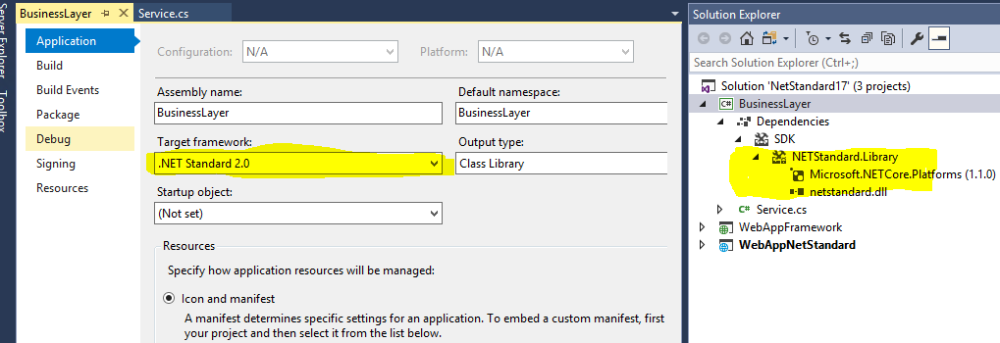
.Net Core in VS 2017

Slide 24
RECAP...
What are Portable Class Libraries?
Why PCL is replacement of NetStandard?

Slide 25
Demo
Creating Portable Class library and Shared library libraries.
Visual Studio 2015 introduced a new type of project template – Shared Project. It was added for the first time in Visual Studio 2013 update 2.
Portable Class library was introduced in Visual Studio 2012 in .Net 4.5

Slide 26
RECAP...
What is NetStandard?
NetStandard Version and respective Compatible Frameworks?

Slide 27
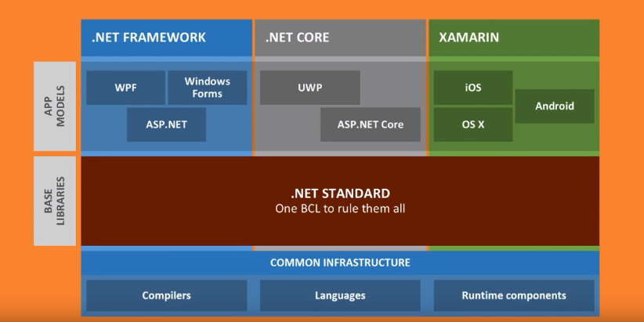
.Net

Slide 28
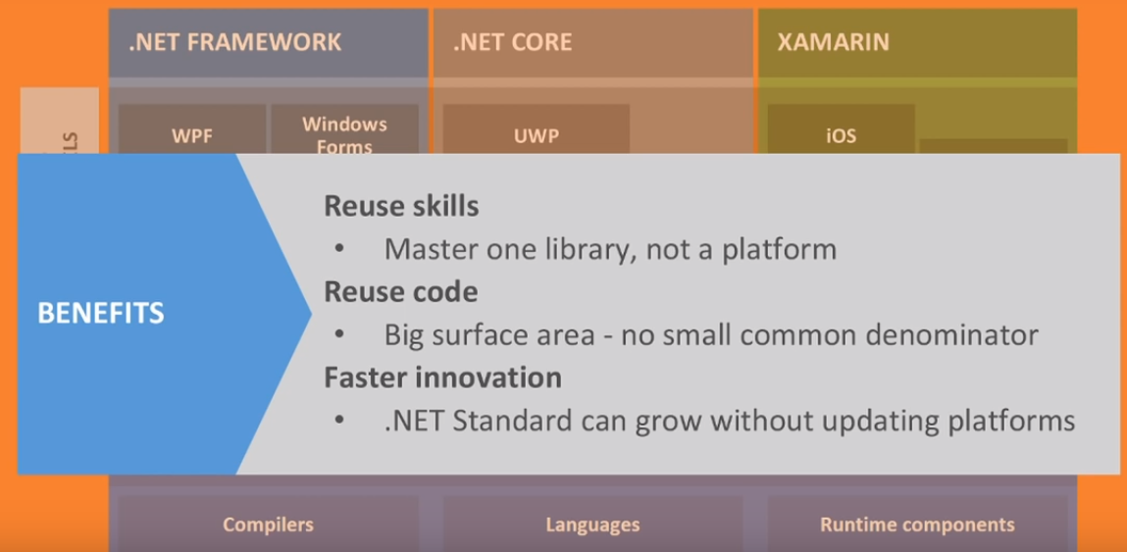
.NET

Slide 29
How is .NET Standard different from .NET Core?
.NET Standard is a specification that covers which APIs a .NET platform has to implement.
.NET Core is a concrete .NET platform and implements the .NET Standard.

Slide 30
Performance
.NET Core includes the .NET runtime, a set of framework libraries, a set of software development kit tools and language compilers. .NET Standard is an API spec that describes the .NET interfaces that developers can use across all .NET platforms.
NET Core 2.0 provides performance improvements in the runtime and framework. It adds support for .NET to six new platforms, including Debian Stretch, SUSE Linux Enterprise Server 12 SP2 and macOS High Sierra.

Slide 31
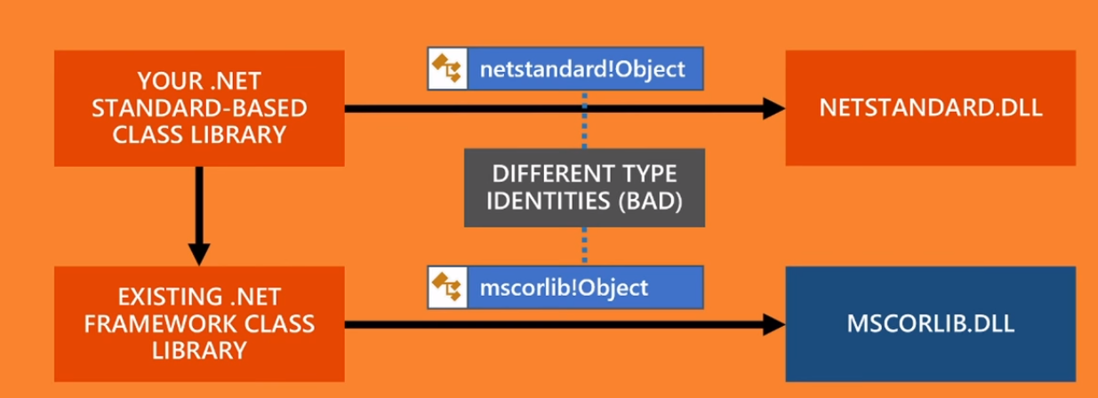
.NetStandard vs .Net Framework

Slide 32
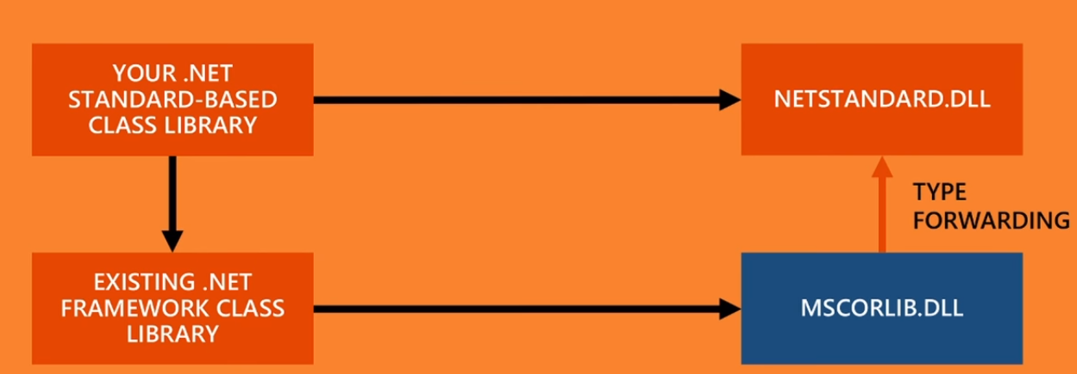
.NetStandard vs .Net Framework

Slide 33
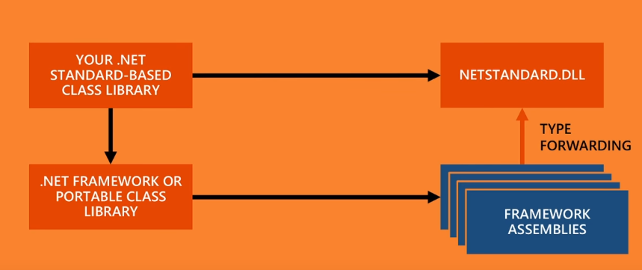
.NetStandard vs .Net Framework

Slide 34
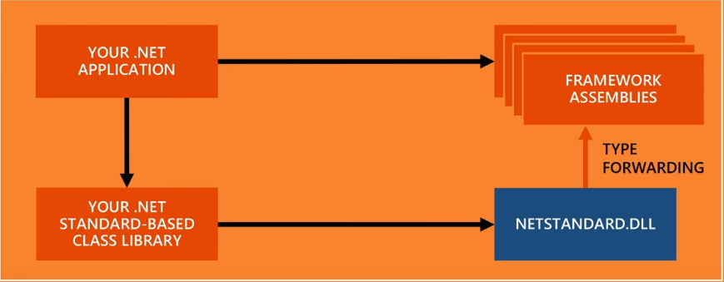
.NetStandard vs .Net Framework

Slide 35

Type Forwarding
Type forwarding allows us to move a type from its original assembly to another assembly in such a way that there is no need to recompile the applications referring to the original assembly.
Type Forwarding is a feature of Common Language Runtime.

Slide 36
Demo
Type Forwarding in Common Language Runtime.

Slide 37
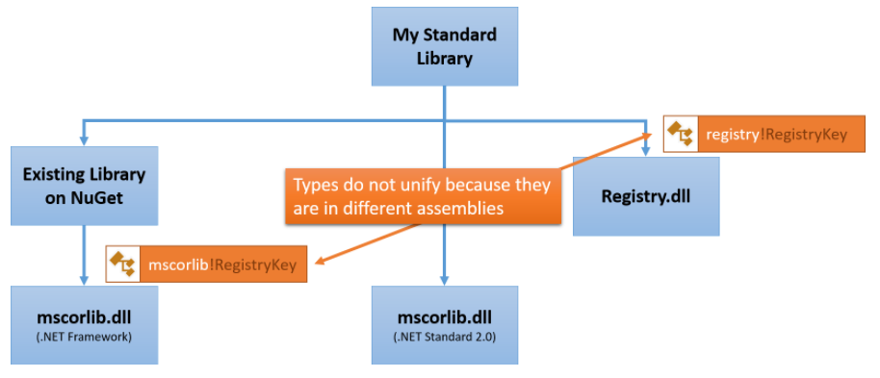
Assembly Unification

Slide 38
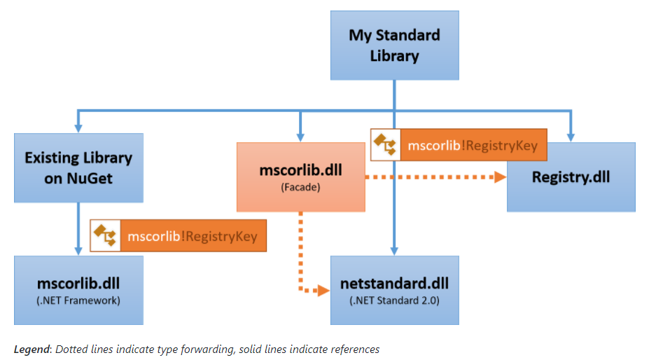
Assembly Unification

Slide 39

Compat Shim
A Shim is a small library which transparently intercepts an API, changes the parameters passed, handles the operation itself, or redirects the operation elsewhere. Shims can also be used for running programs on different software platforms than they were developed for.

Slide 40
Demo
Adding Existing libraries to .Net Standard.

Slide 41
Demo
Converting .Net Framework to .Net Standard

Slide 42
Demo
Upgrading .Net Core Class library to .Net standard

Slide 43
CSProj configuration
With csproj:
<Project Sdk="Microsoft.NET.Sdk">
<PropertyGroup>
<TargetFramework>netstandard2.0</TargetFramework>
</PropertyGroup>
</Project>

Slide 44
Demo
APi Porting : Command Line and Visual Studio
APi Port: The console tool helps you determine how flexible your application.

Slide 45
Cli Commands
Basic Command:
new restore build publish run sln store
Test vstest pack migrate clean help
Project modification Command:
add package add reference remove package remove reference list reference
Advanced Commands:
nuget delete nuget locals nuget push msbuild dotnet install script

Slide 46
Xamarin with NetStandard
Edit the .csProj file to the following.
<Project Sdk="Microsoft.NET.Sdk">
<PropertyGroup>
<TargetFramework>netstandard1.4</TargetFramework>
<PackageTargetFallback>$(PackageTargetFallback);portable-win+net45+wp8+win81+wpa8</PackageTargetFallback>
</PropertyGroup>
Other stuff here
</Project>
This is to tell VS that it will be accepting/compatible of these other frameworks.

Slide 47
Demo
Xamarin referencing .Net Standard

Slide 48
Demo
Demo on Entity Framework
(EF6 vs EntityFrameworkCore)

Slide 49
Demo
Encryption and Decryption using .Net Standard.
(DataProtection vs MachineKey)

Slide 50
Demo
Thread Pool concepts
The ThreadPool class provides your application with a pool of worker threads that are managed by the system, allowing you to concentrate on application tasks rather than thread management.

Slide 51
Demo
Conversion of .Net Framework to .Net Core

Slide 52
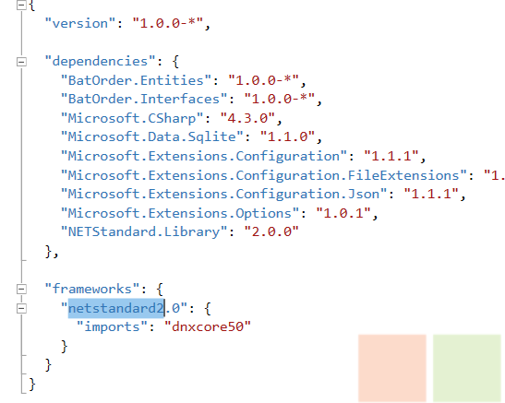
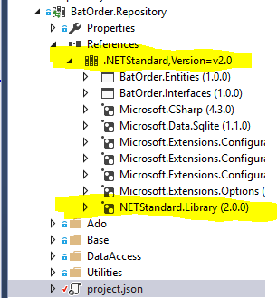
.Net Core in VS2015 with .Net Standard 2.0

Slide 53

Presentation Layer and Framework target
In Visual Studio 2015 .net core is executable project type and targeting .netstandard for an executable project type is not supported.
WinForms: we can reference ClassLibrary (Portable) with target as .netstandard1.4 which targets Framework4.6.2
Console: we can reference ClassLibrary (Portable) with target as .netstandard1.4 which targets Framework4.6.2
WPF: we can reference ClassLibrary (Portable) with target as .netstandard1.4 which targets Framework4.6.2

Slide 54
Project.json configuration
With project.json:
"frameworks": {
"netcoreapp1.1": {
"dependencies": { },
"imports": [ "netstandard2.0", "Portable-net45+win10" ] } }

Slide 55
NetStandard Library Extensions
Extensions for missing functionality in .NET Standard Library:
NETStandard.Library.Extensions
NETStandard.Library.Extensions.EntityFrameworkCore

Slide 56
.NET Standard Comparisons
https://github.com/dotnet/standard/blob/master/docs/comparisons/netstandard2.0_vs_net461/README.md
https://github.com/dotnet/standard/tree/master/docs/comparisons
https://github.com/dotnet/standard/blob/master/docs/versions/netstandard1.6.md
https://github.com/dotnet/standard/blob/master/docs/versions/netstandard2.0.md
https://docs.microsoft.com/en-us/dotnet/standard/net-standard

Slide 57
Useful links
http://www.c-sharpcorner.com/article/what-is-net-standard/
http://www.codedigest.com/quick-start/9/what-is-netstandard
https://github.com/dotnet/standard/blob/master/docs/versions/netstandard2.0.md
https://elanderson.net/2016/10/create-a-net-standard-library-for-use-with-full-net-framework/
https://github.com/dotnet/corefx/issues/18217
https://github.com/dotnet/standard/blob/master/netstandard/src/ApiCompatBaseline.net461.txt.
https://www.cameronmoten.com/2017/08/19/fixing-xamarin-with-net-standard-in-visual-studio-2017-v-15-3/

Slide 58
Thank You

